Slide 1
Wills Seminar
Bob Maxwell
Jeff Toner
January 8, 2023

Slide 2
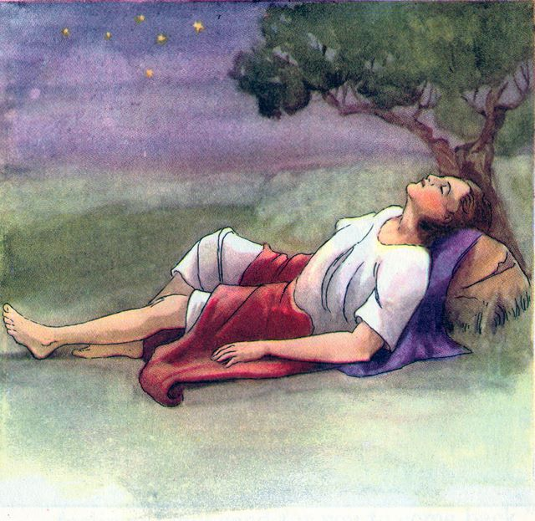
Jacob and Leah
Married
12 sons-5 from current marriage
House - in joint names
Bank Account – in joint names
Jacob has:
Life insurance – Leah beneficiary
IRA – Leah beneficiary
$1,000,000 bank account

Slide 3
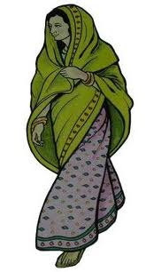
Jacob dies
House
Life insurance
Joint Bank Account
IRA
Bank Account

Slide 4
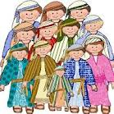
What if Leah dies without a will?
What happens to:
House?
Bank Account?
Who will distribute?
Who will take care of children?

Slide 5
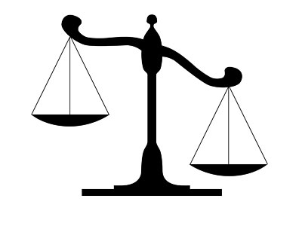
Will or Intestate Law
DOES NOT apply to:
Life Insurance
IRAs
Jointly held property with rights of survivorship
Tenancy by the entireties (husband and wife)
Trust assets
Pay on Death Accounts

Slide 6
Will or Intestate Law
APPLIES TO:
Assets in sole name

Slide 7
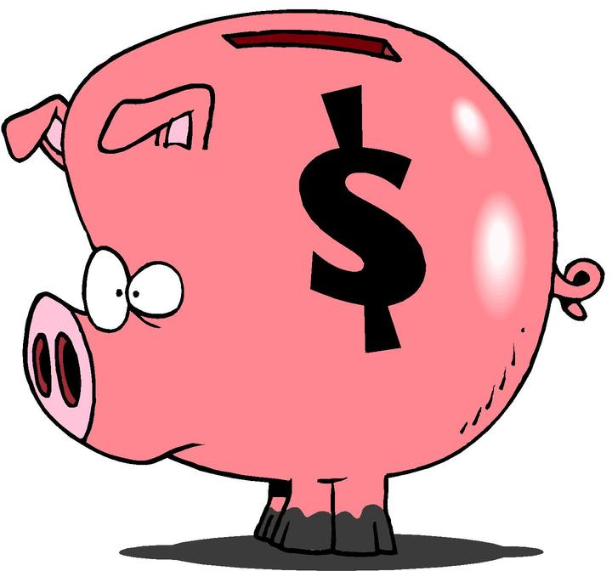
Intestate Law – Pennsylvania
Jacob and Leah
12 children
Jacob father of all 12
Leah mother of only 6 of 12
Jacob - $1,000,000 Bank Account in his own name.

Slide 8
Jacob’s Dream
…Jacob made a vow, saying, ‘If God will be with me, and will keep me in this way that I go, and will give me bread to eat and clothing to wear, ²¹so that I come again to my father’s house in peace, then the Lord shall be my God, ²²and this stone, which I have set up for a pillar, shall be God’s house; and of all that you give me I will surely give one-tenth to you.’

Slide 9
Intestate Law – Pennsylvania
Who shares the $1,000,000 when Jacob dies?
Leah gets $500,000 (one half)
Children share $500,000 (one half)
$41,666.66 each

Slide 10
Intestate Law - Problems
Is this what Jacob wanted?
Who will distribute the $1,000,000?
Children with $41,666?
Who will take care of children?
What about Charity?

Slide 11
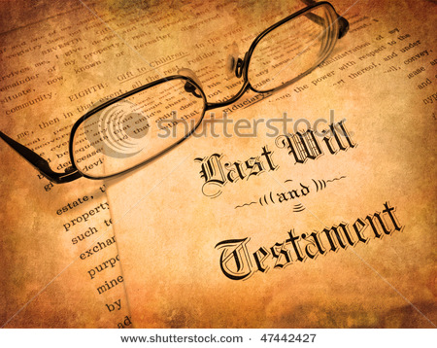
Wills - Advantages
Decide who gets what
Name an Executor/Executrix
Name a Guardian for Children

Slide 12
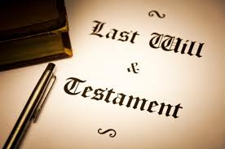
Wills - Pennsylvania
18 or older
Sound mind
In writing
Signed

Slide 13
Wills – Can I change my will?
“Last” Will
Revoke Prior Wills
Codicil

Slide 14
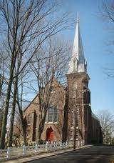
Wills - Beneficiaries
People
Wife
12 children
Contingent Beneficiaries
Charities/Organizations
Doylestown Presbyterian Church
Causes
SPCA, Doylestown Historical Society

Slide 15
Wills - Bequests
Specific bequests
$ Dollar amount or item to
Organization
Charity
Person
Residuary bequests
What is left after taxes, debts, fees

Slide 16
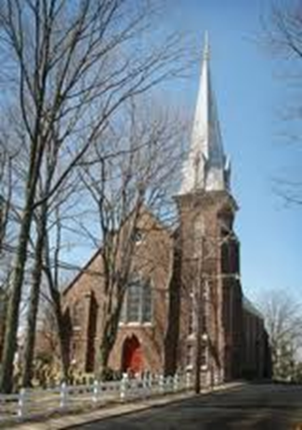
Gifts to Charity under Will
Specific Bequest
I give $10,000 to Doylestown Presbyterian Church
Percent of Residue
50% of the residue of my estate to Doylestown Presbyterian Church

Slide 17
Gifts to Charity under Will
Charity benefits
No Federal Estate Tax
No Pennsylvania Inheritance Tax

Slide 18
Wills – Executor/ Executrix
Executor’s Job:
Identify and gather assets
Probate Will
Manage and safeguard assets
Pay Debts
Pay taxes
Last income tax return
Inheritance Tax, Estate Tax
Distribute assets according to Will

Slide 19
Executor / Executrix
Person (or persons)
Bank
Trust Company
Name alternate Executor / Executrix
Executor can charge a fee

Slide 20
Wills - Guardians
Minor children
Guardian
Day-to-day decisions
School
Medical treatment
Manage assets under will
Deal with life insurance proceeds
Other assets

Slide 21
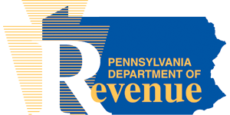
PA Inheritance Tax Rates
To spouse: 0%
Parent to child 21 or younger: 0%
From child 21 or younger to parent: 0%
To child or grandchild: 4.5%
To brother or sister: 12%
To unrelated person: 15%
To charity: 0%

Slide 22
Federal Estate Tax
To spouse: 0%
To charity: 0%
2022
40% rate
Amount over $12,060,000
2023
40% rate
Amount over $12,920,00

Slide 23
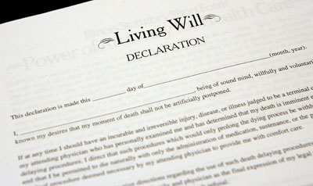
Other Documents:
Durable Power of Attorney
Living Will
Lifetime Trust
Revocable
Irrevocable

Slide 24
Wills - Advantages
Decide who gets what
Name an Executor/Executrix
Name a Guardian for Children
Set up trusts
For children
For spouse
For charity

Slide 25
Action Steps:
Review your assets
Identify your Beneficiaries
Think of Executors
Meet with an attorney to make a will or update your Will

Slide 26
References
www.PresbyterianFoundation.org
Composing a Legacy
https://www.presbyterianfoundation.org/wp-content/uploads/2017/09/10011-PFD-Composing-a-Legacy-Rebrand-F-nocrops.pdf
Estate Planning Workbook
10009-PFD-Estate-Planning-Workbook-Rebrand-F-nocrops.pdf (presbyterianfoundation.org)
Estate Planning Worksheet
https://www.schwab.com/resource/asset-inventory-worksheet
Estate Planning Questions
https://www.actec.org/estate-planning/

